Slide 1
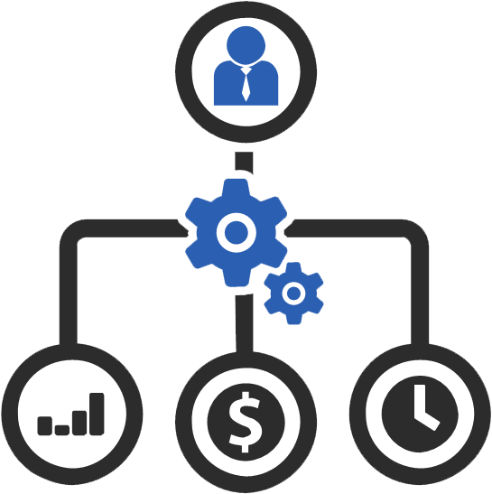
Project Management And Collaboration Tools
Mohammad Mahdi Mohajer
Pourya Pouryeganeh
Farshid Adavi
Fall 2019
ALLPPT.com _ Free PowerPoint Templates, Diagrams and Charts

Slide 2
Project Management Tools
Lightweight : Designed for short, temporary projects or teams with lightweight processes.
Midweight : More elaborate tools, used when you need to balance more complicated processes and ease of use.
Heavyweight : Tools used when you have really elaborate processes and need to customize a lot of
components Project to fit them.

Slide 3

Introduction to #slack

Slide 4
What is Slack?
• Slack is a messaging app for teams.
• Is available across a range of devices and platforms
• Works with other apps too, including Skype for video calls

Slide 5

Slack History
• Created by Flickr co-founder Stewart Butterfield
• Slack was launched in August 2013
• Slack Valuation: $1.2 to $2.8 Billion in 6 months

Slide 6
Slack
Software Capabilities and Features

Slide 7
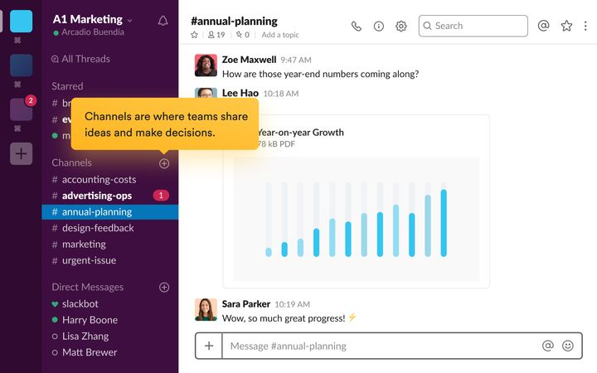
Slack Channels and Private Channels

Slide 8
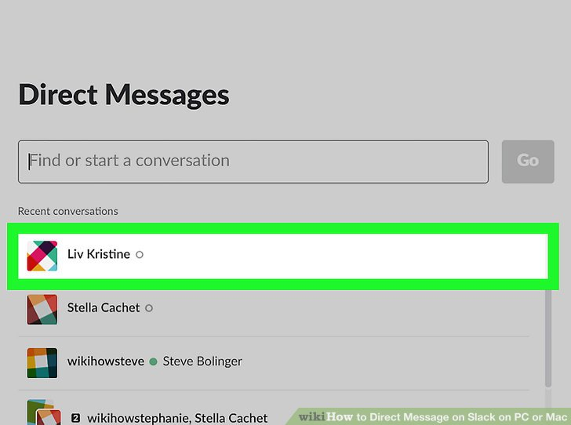
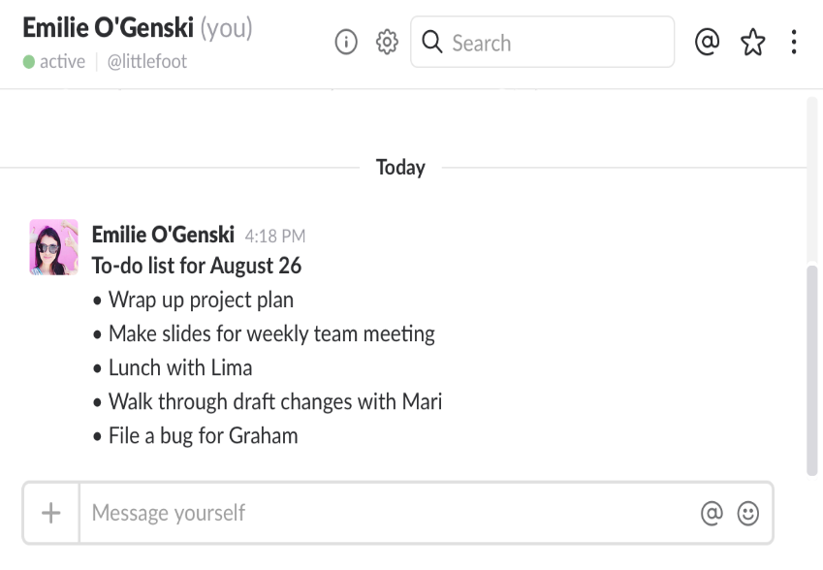
Slack Direct Message

Slide 9
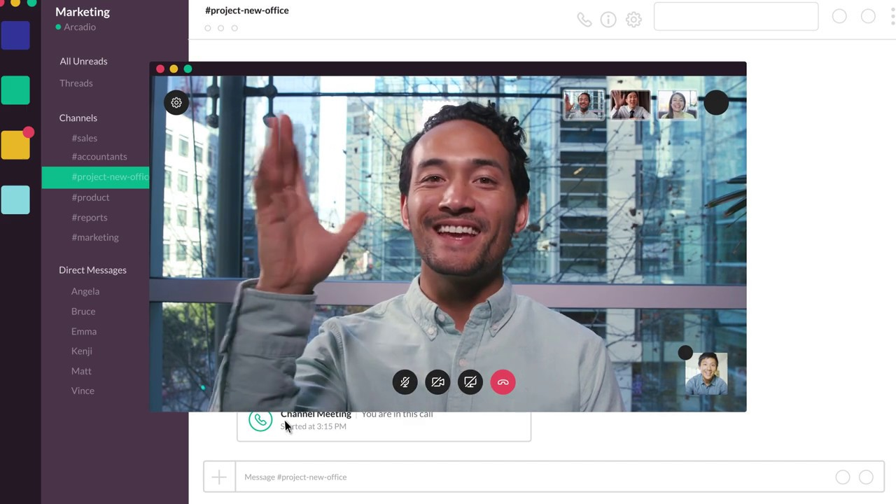
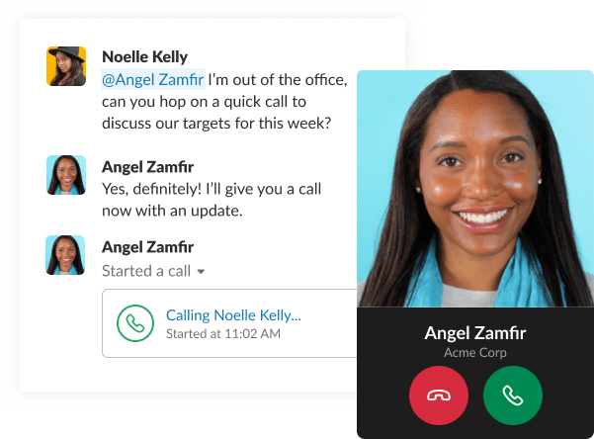
Slack Calls in Channels and Direct Messages

Slide 10
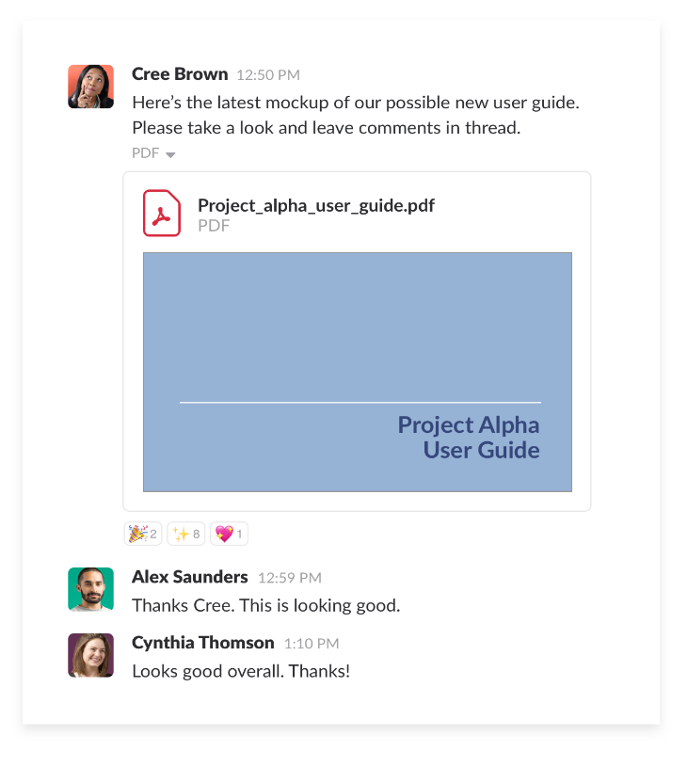
Slack Drag, Drop, For Sharing your files

Slide 11

Slack Integration With Other Apps

Slide 12

SlackBot
SlackBot: personal assistant and helpful bot

Slide 13
Conclusion : Slack

Slide 14
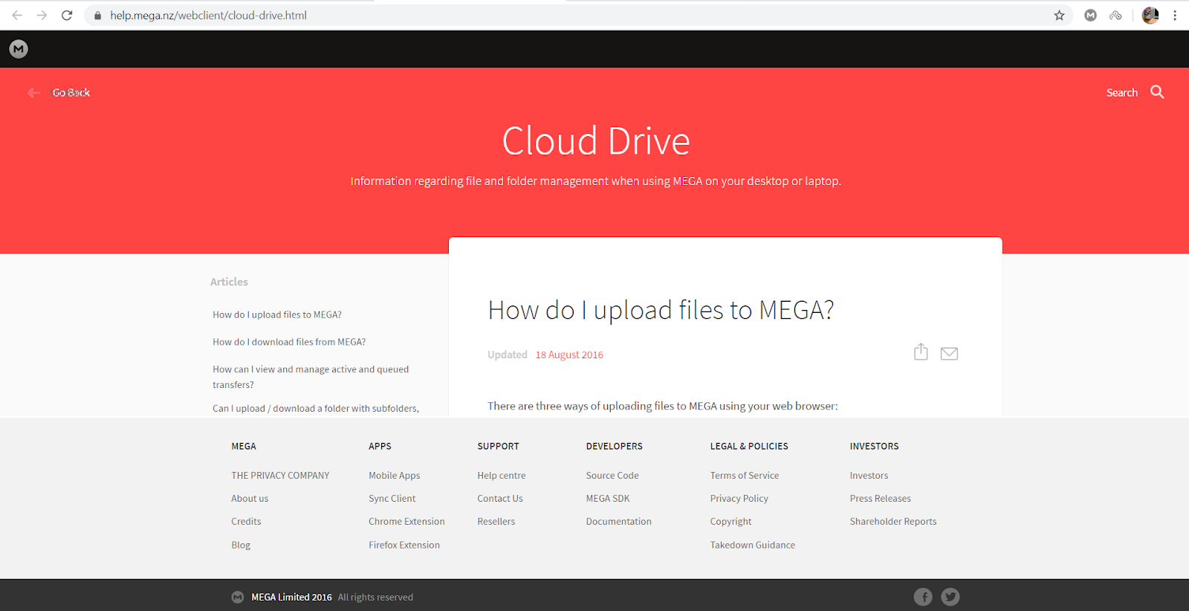
What is MEGA

Slide 15
What does MEGA do?

Slide 16
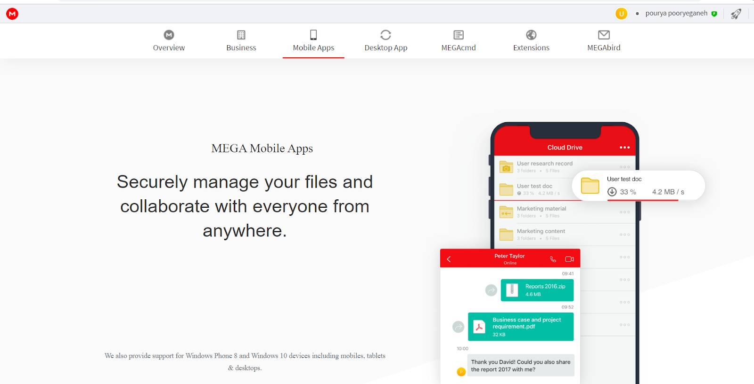

Slide 17
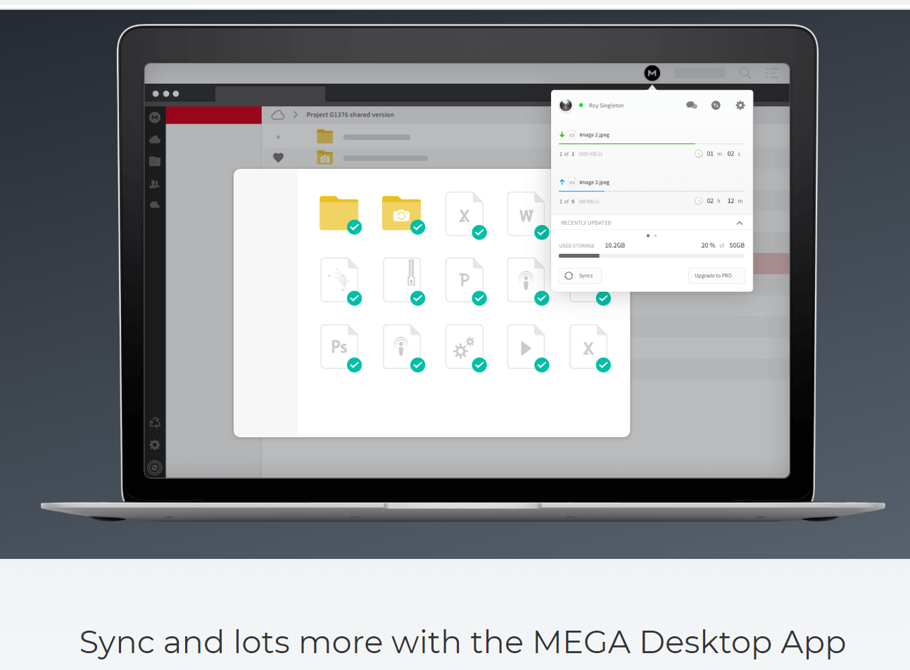

Slide 18
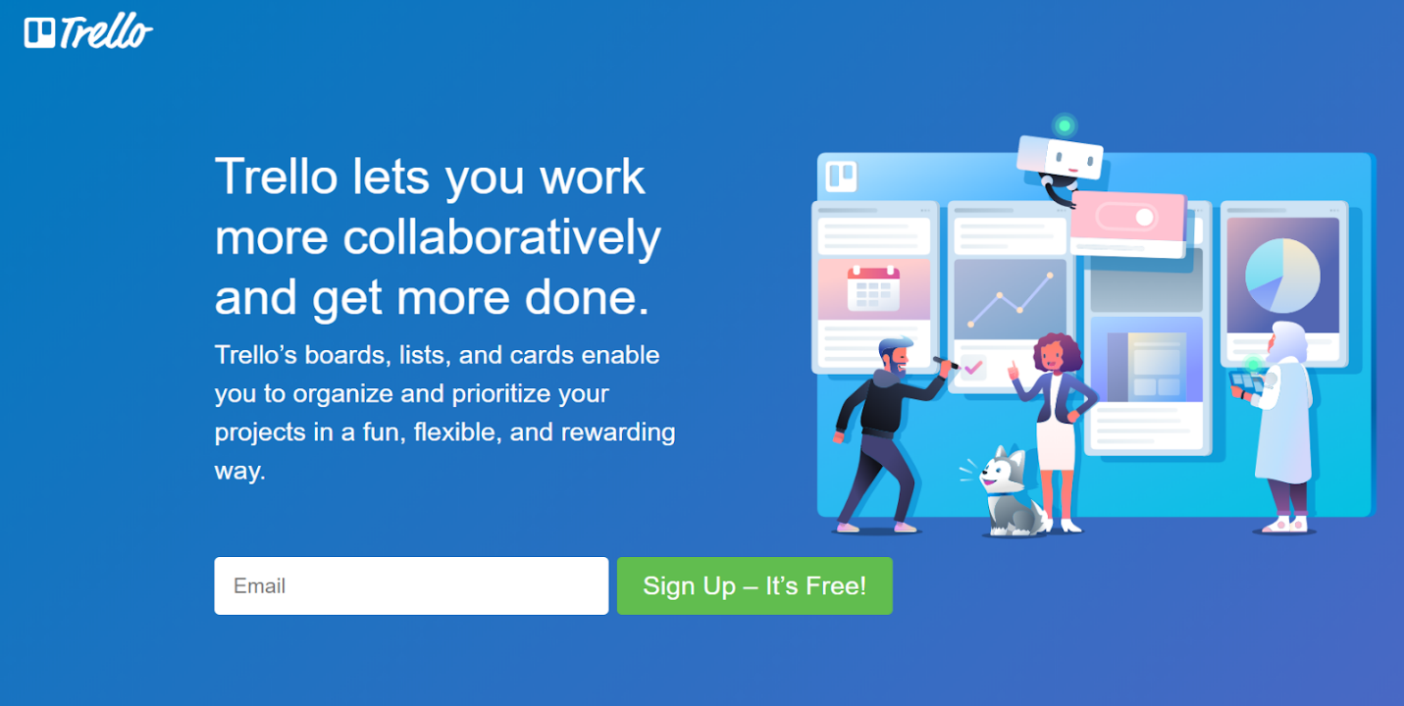
Hello Trello !

Slide 19
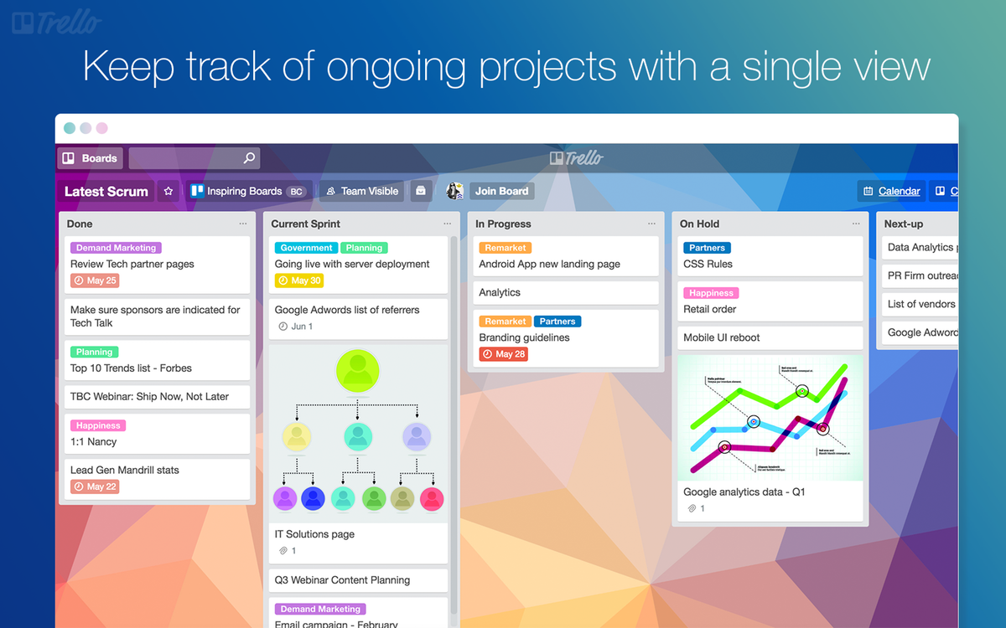

Slide 20
